Slide 1
Inhealth
Spectra Discovery Project-
Low Level Design Review Session

Slide 2

Agenda
01
Executive Summary
02
Architecture Overview
03
Migration Approach & Phasing
04
Application Modernisation
05
Security, Compliance & Governance

Slide 3
Agenda
06
Disaster Recovery & Operational Model
07
Azure Sizing & Costing (High Level)
08
Cost Optimisation Options
09
Key Benefits & Next Steps
10
AOB

Slide 4
EXECUTIVE SUMMARY
InHealth is modernising the Spectra DESP and Lung Screening platforms by migrating from on-premises infrastructure to Microsoft Azure.
The Low-Level Design (LLD) defines a repeatable, secure, scalable and clinically safe architecture built using:
Hub-and-Spoke Azure Landing Zone
Container-based App Services for all workloads
Azure Files Premium for high-performance clinical imaging
Azure PostgreSQL Flexible Server per programme instance
Lift-and-shift Harmony PACS running on Azure VMs with Premium SSD v2/Ultra disks
The migration strategy prioritises:
Minimal clinical disruption and data integrity
Strict data residency and private-only networking
Programme-level isolation for DESP and Lung
A phased delivery model starting with a POC vertical slice, followed by Dev/Test, and then programme-by-programme production cutovers
Outcome: A resilient, secure, modern cloud platform that enhances clinical performance, improves reliability, reduces operational overhead, and provides clear cost transparency.

Slide 5
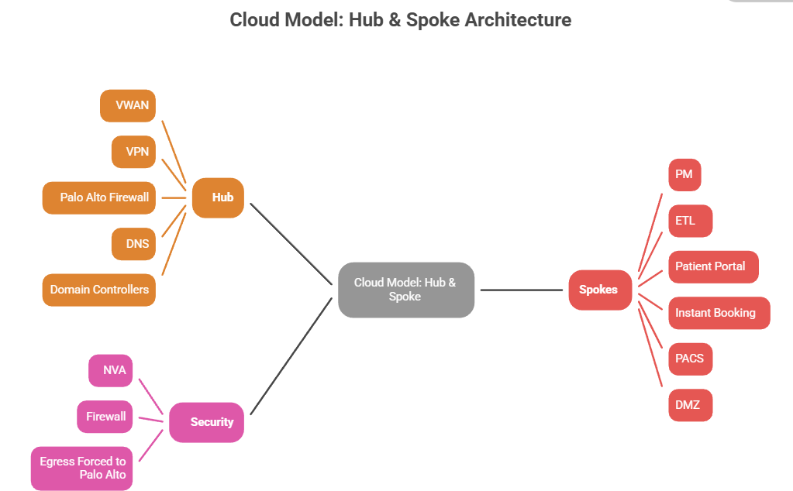
Architecture Overview
The Spectra Azure architecture is designed as a secure, scalable, and repeatable model using InHealth’s Hub-and-Spoke Landing Zone.

Slide 6
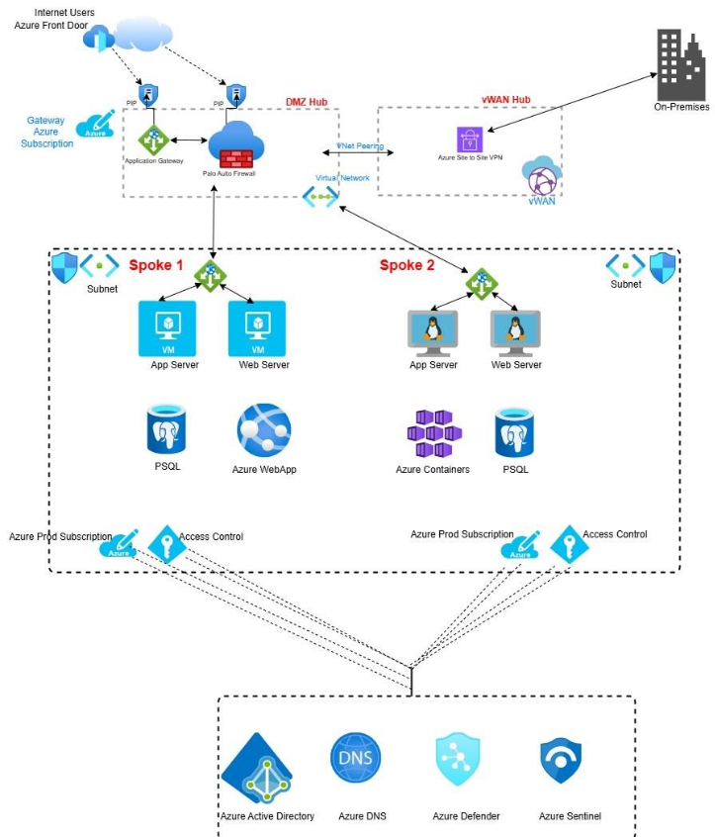
Architecture Overview

Slide 7
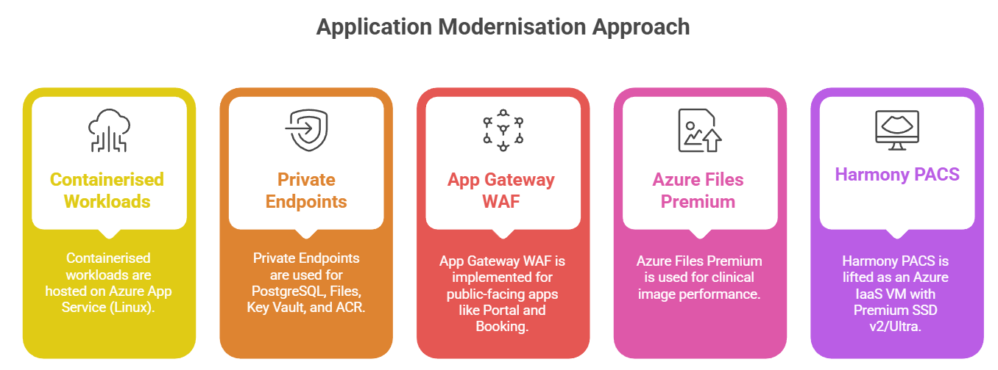
Architecture Overview

Slide 8
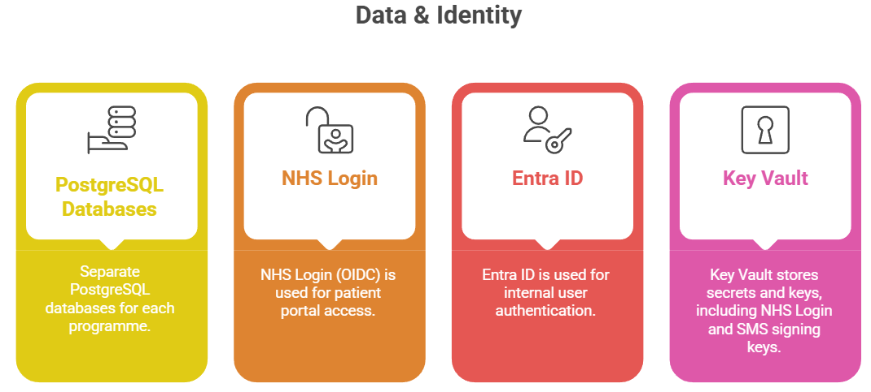
Architecture Overview
Notes:
Aligning Reliability, Performance and Cost Efficiency
Key Points:
Right size – Collect baseline data - Use AWS Compute Optimizer for recommendations
Validate – Pilot workloads, simulate demand
Run for 4-6 weeks
Optimise – Refine sizing post-migration
Evidence-driven, continuous, and transparent optimisation
Delivering performance and value through intelligent right-sizing

Slide 9
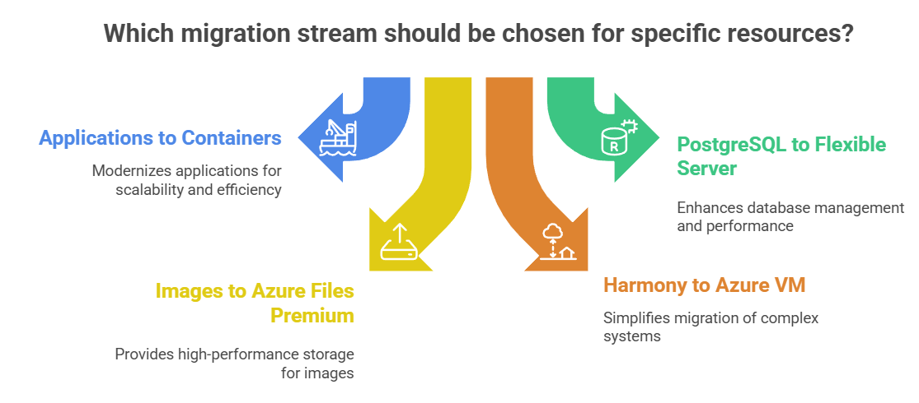
Key Migration Streams

Slide 10
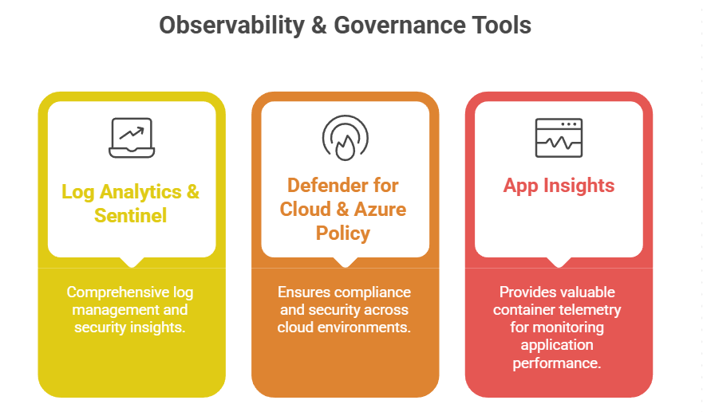
Architecture Overview

Slide 11
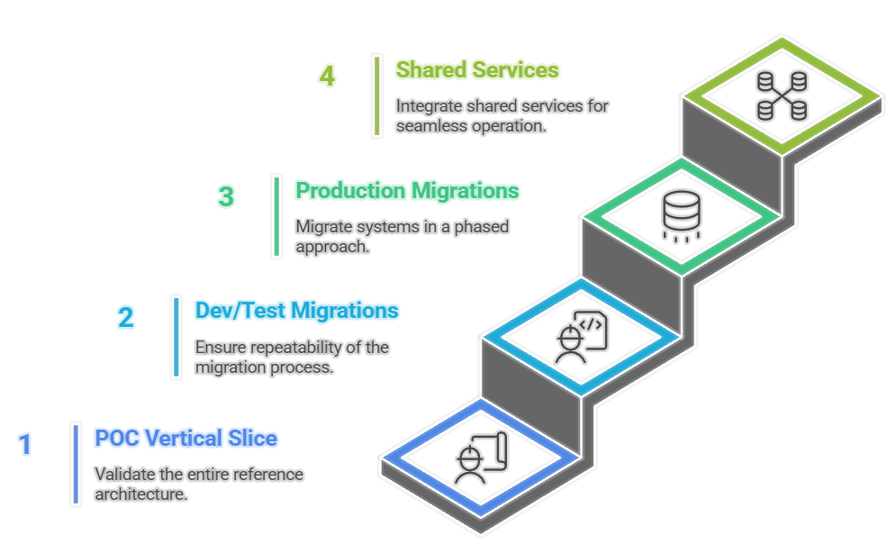
Programme-by-programme migration

Slide 12
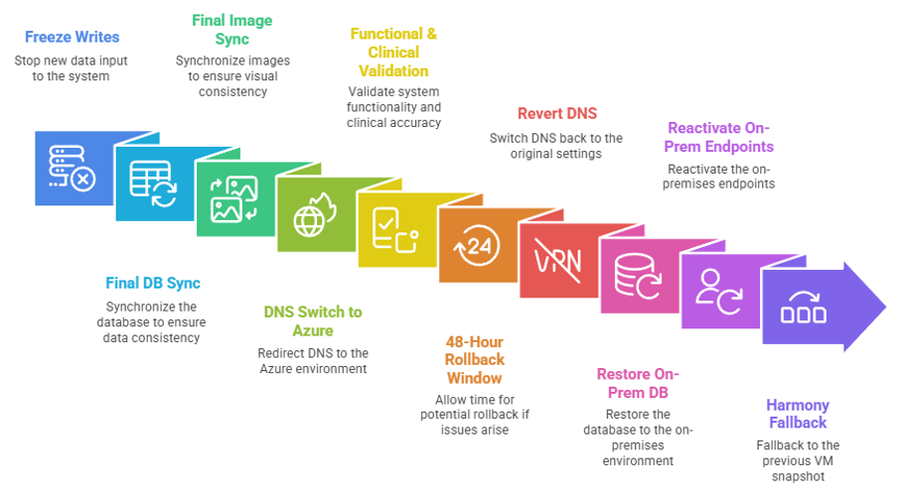
Cutover Plan (Per Programme) AND rOLLBACK

Slide 13
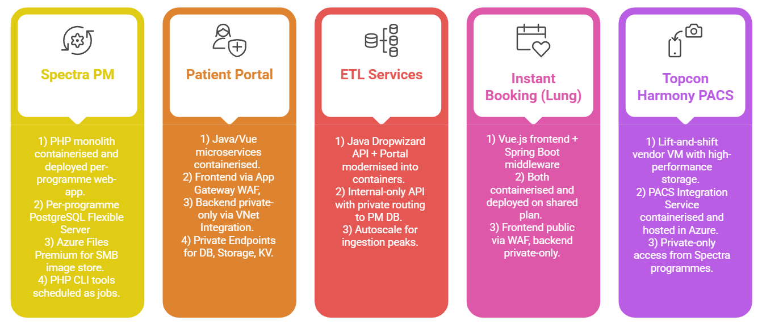
Application ModerniSation
Notes:
When it comes to Disaster Recovery and Backup, we’ve followed a clear, structured framework to determine the best-fit solution for Thurrock.
We began by assessing technical, operational, and compliance needs including UK data residency, immutability, and encryption and then evaluated your existing solution (Veeam) and AWS Backup options
The next slide shows a comparison table:

Slide 14
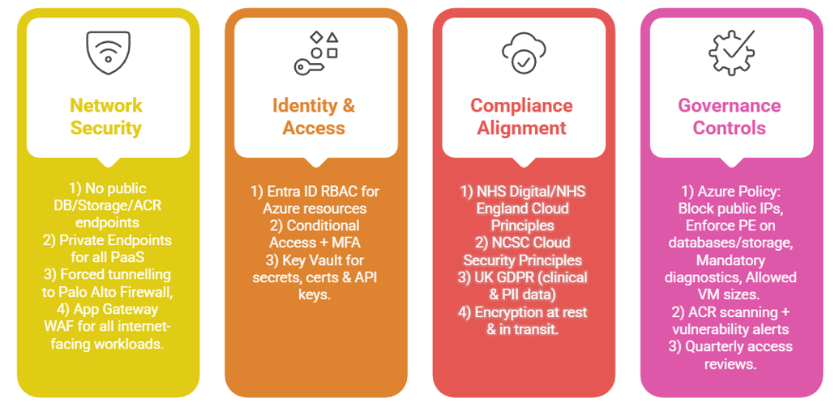
Security, Compliance & Governance
Notes:
Visuals:
Power BI dashboard mock-up
CUR integration view (spend by department, anomaly alerts)
Speaker: Omkar Key Points:
Real-time spend visibility
Forecasting & anomaly detection
Chargeback/showback models for transparency

Slide 15
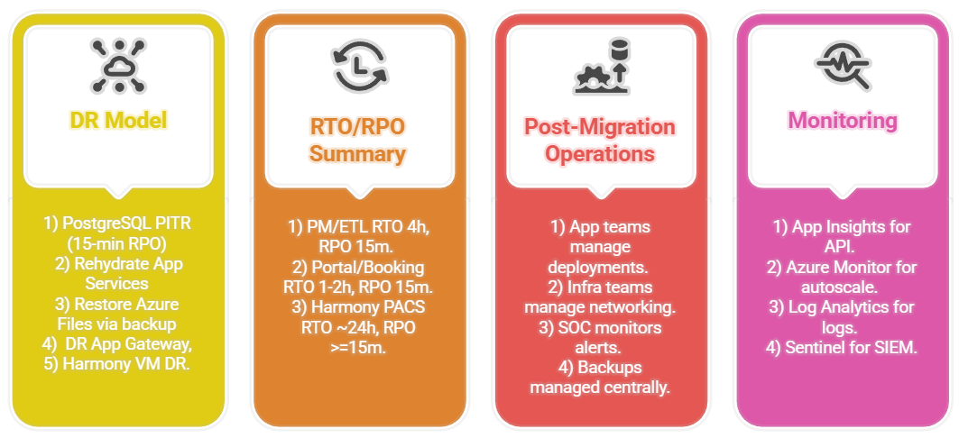
Disaster Recovery & Operational Model
Notes:
Our partnership with Thurrock doesn’t end at go-live.
This final piece is about how Mastek ensures sustained value long after migration.
Through what we call the Thurrock Cloud Value Hub, we bring together automation, FinOps excellence, training, AI enablement.
We embed automation, cost visibility, and skills transfer into everything we deliver ensuring your team remains in control, your platform stays optimised, and your costs stay predictable.
Whether it’s leveraging AWS programs (like OGVA, MAP, and OLA), integrating GenAI, or simply making sure your workloads stay right-sized and cost-efficient, we’re committed to ensuring Thurrock’s cloud continues to evolve delivering lasting value.
🚫 Avoiding Vendor Lock-In
Multi-cloud ready architectures and open-source tooling for portability.
🧩 Ongoing Support
3 days/month post-migration support for incidents, optimisation, and coaching. Collaboration with AWS Enterprise Support and Technical Account Managers (TAMs).
💰 FinOps Excellence
Power BI dashboards integrating AWS CUR and Cost Explorer for transparency. Ongoing monthly optimisation reviews to avoid stranded costs.
==================================================================================================
🔁 Automation & Optimisation
Automated provisioning, patching, and scaling using Terraform & AWS SSM. Continuous rightsizing and performance tuning to minimise waste.
🧠 GenAI Enablement
Identify use cases (service desk, citizen portals, document automation) leveraging AWS Bedrock and Q.
📊 Governance & Reporting
Executive dashboards showing cost, performance, security posture, and compliance trends.
🧩 Ongoing Support
3 days/month post-migration support for incidents, optimisation, and coaching. Collaboration with AWS Enterprise Support and Technical Account Managers (TAMs).
📜 Funding & Frameworks
Leverage OLA, OGVA, and MAP to unlock AWS credits, rebates, and migration funding.
💰 FinOps Excellence
Power BI dashboards integrating AWS CUR and Cost Explorer for transparency. Ongoing monthly optimisation reviews to avoid stranded costs.
🎓 Training & Knowledge Transfer
Hands-on upskilling for Thurrock’s ICT team through shadowing, KT sessions, and self-paced labs.
🚫 Avoiding Vendor Lock-In
Multi-cloud ready architectures and open-source tooling for portability.

Slide 16

Azure Sizing & Costing

Slide 17
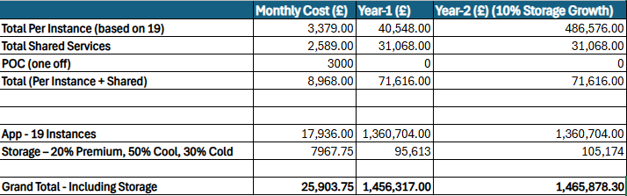
AZURE SIZING AND COSTING
Cost estimates are based on a worst-case scenario using the current data available. Some gaps remain due to incomplete information from the Discovery tool (Dr. Migrate)
Cost per month is calculated per programme instance
Shared services and shared storage remain static
POC cost is a one-off
Storage costs are calculated by tiering (Premium, Cool, Cold)
Grand Total represents the full annual cost Year-3 costs are expected to decrease
Notes:
Our partnership with Thurrock doesn’t end at go-live.
This final piece is about how Mastek ensures sustained value long after migration.
Through what we call the Thurrock Cloud Value Hub, we bring together automation, FinOps excellence, training, AI enablement.
We embed automation, cost visibility, and skills transfer into everything we deliver ensuring your team remains in control, your platform stays optimised, and your costs stay predictable.
Whether it’s leveraging AWS programs (like OGVA, MAP, and OLA), integrating GenAI, or simply making sure your workloads stay right-sized and cost-efficient, we’re committed to ensuring Thurrock’s cloud continues to evolve delivering lasting value.
🚫 Avoiding Vendor Lock-In
Multi-cloud ready architectures and open-source tooling for portability.
🧩 Ongoing Support
3 days/month post-migration support for incidents, optimisation, and coaching. Collaboration with AWS Enterprise Support and Technical Account Managers (TAMs).
💰 FinOps Excellence
Power BI dashboards integrating AWS CUR and Cost Explorer for transparency. Ongoing monthly optimisation reviews to avoid stranded costs.
==================================================================================================
🔁 Automation & Optimisation
Automated provisioning, patching, and scaling using Terraform & AWS SSM. Continuous rightsizing and performance tuning to minimise waste.
🧠 GenAI Enablement
Identify use cases (service desk, citizen portals, document automation) leveraging AWS Bedrock and Q.
📊 Governance & Reporting
Executive dashboards showing cost, performance, security posture, and compliance trends.
🧩 Ongoing Support
3 days/month post-migration support for incidents, optimisation, and coaching. Collaboration with AWS Enterprise Support and Technical Account Managers (TAMs).
📜 Funding & Frameworks
Leverage OLA, OGVA, and MAP to unlock AWS credits, rebates, and migration funding.
💰 FinOps Excellence
Power BI dashboards integrating AWS CUR and Cost Explorer for transparency. Ongoing monthly optimisation reviews to avoid stranded costs.
🎓 Training & Knowledge Transfer
Hands-on upskilling for Thurrock’s ICT team through shadowing, KT sessions, and self-paced labs.
🚫 Avoiding Vendor Lock-In
Multi-cloud ready architectures and open-source tooling for portability.

Slide 18
Cost Optimisation Options

Slide 19
Cost Optimisation Options
Optimisation 1 — Consolidate App Service Plans
Risk | Description
Performance contention | One app consuming high CPU/memory impacts others (“noisy neighbour”).
Bigger blast radius | Restarting the shared App Service Plan affects all apps hosted on it.
Loss of release independence | Deployment or configuration changes on one app may require restarts of the entire plan.
Security boundary dilution | Sharing infrastructure may reduce perceived isolation between clinical and non-clinical apps.
Harder cost attribution | Cost split across multiple programmes may become unclear.
What we can do
Move multiple low-usage workloads onto a shared App Service Plan (ASP) instead of separate P1v3/P2v3 plans
Consolidation examples:
PM + PM Background Jobs (same programme)
Patient Portal + Portal Image Service
Instant Booking + Booking Middleware
ETL Service + ETL Portal (if still active)
Expected Saving
30–45% per programme
Mitigation
Right-size the ASP (use P2v3 for heavy workloads) and monitor capacity (CPU, memory, HTTP queue).
Autoscale rules to expand during peaks.
Set per-app CPU throttling using App Service quotas for non-critical apps.
Apply strict deployment windows to avoid clashes.
Use Azure Tags for full programme-level cost attribution.
Split out high-load apps (e.g., PACS Integration) into dedicated plans if needed.
Notes:
Our partnership with Thurrock doesn’t end at go-live.
This final piece is about how Mastek ensures sustained value long after migration.
Through what we call the Thurrock Cloud Value Hub, we bring together automation, FinOps excellence, training, AI enablement.
We embed automation, cost visibility, and skills transfer into everything we deliver ensuring your team remains in control, your platform stays optimised, and your costs stay predictable.
Whether it’s leveraging AWS programs (like OGVA, MAP, and OLA), integrating GenAI, or simply making sure your workloads stay right-sized and cost-efficient, we’re committed to ensuring Thurrock’s cloud continues to evolve delivering lasting value.
🚫 Avoiding Vendor Lock-In
Multi-cloud ready architectures and open-source tooling for portability.
🧩 Ongoing Support
3 days/month post-migration support for incidents, optimisation, and coaching. Collaboration with AWS Enterprise Support and Technical Account Managers (TAMs).
💰 FinOps Excellence
Power BI dashboards integrating AWS CUR and Cost Explorer for transparency. Ongoing monthly optimisation reviews to avoid stranded costs.
==================================================================================================
🔁 Automation & Optimisation
Automated provisioning, patching, and scaling using Terraform & AWS SSM. Continuous rightsizing and performance tuning to minimise waste.
🧠 GenAI Enablement
Identify use cases (service desk, citizen portals, document automation) leveraging AWS Bedrock and Q.
📊 Governance & Reporting
Executive dashboards showing cost, performance, security posture, and compliance trends.
🧩 Ongoing Support
3 days/month post-migration support for incidents, optimisation, and coaching. Collaboration with AWS Enterprise Support and Technical Account Managers (TAMs).
📜 Funding & Frameworks
Leverage OLA, OGVA, and MAP to unlock AWS credits, rebates, and migration funding.
💰 FinOps Excellence
Power BI dashboards integrating AWS CUR and Cost Explorer for transparency. Ongoing monthly optimisation reviews to avoid stranded costs.
🎓 Training & Knowledge Transfer
Hands-on upskilling for Thurrock’s ICT team through shadowing, KT sessions, and self-paced labs.
🚫 Avoiding Vendor Lock-In
Multi-cloud ready architectures and open-source tooling for portability.

Slide 20
Cost Optimisation Options
Optimisation 2 — Auto-Scale + Auto-Shrink
What we can do
Create autoscale rules that dynamically adjust instance count:
Scale-Out Triggers
CPU > 60%
HTTP queue > 20
Scale-In
Reduce to 1 instance between 9 PM – 6 AM if load is minimal.
Expected Saving
15–35%
Risk | Description
Unexpected auto-scale down | Can reduce capacity during late-running clinical tasks or spikes.
Cold-start delay | Apps may take a few seconds to warm up after scaling in.
Costs increase if scale-out misconfigured | Poor rules may trigger unnecessary scaling.
Mitigation
Use per-app warmup settings (Always On = Enabled).
Use scheduled scale-down, not only metric-triggered.
Tune autoscale over 2–4 weeks via real usage patterns.
Set minimum 2 instances for patient-facing workloads (Portal/Booking) during business hours.
Pilot autoscale in Dev/Test first.
Notes:
Our partnership with Thurrock doesn’t end at go-live.
This final piece is about how Mastek ensures sustained value long after migration.
Through what we call the Thurrock Cloud Value Hub, we bring together automation, FinOps excellence, training, AI enablement.
We embed automation, cost visibility, and skills transfer into everything we deliver ensuring your team remains in control, your platform stays optimised, and your costs stay predictable.
Whether it’s leveraging AWS programs (like OGVA, MAP, and OLA), integrating GenAI, or simply making sure your workloads stay right-sized and cost-efficient, we’re committed to ensuring Thurrock’s cloud continues to evolve delivering lasting value.
🚫 Avoiding Vendor Lock-In
Multi-cloud ready architectures and open-source tooling for portability.
🧩 Ongoing Support
3 days/month post-migration support for incidents, optimisation, and coaching. Collaboration with AWS Enterprise Support and Technical Account Managers (TAMs).
💰 FinOps Excellence
Power BI dashboards integrating AWS CUR and Cost Explorer for transparency. Ongoing monthly optimisation reviews to avoid stranded costs.
==================================================================================================
🔁 Automation & Optimisation
Automated provisioning, patching, and scaling using Terraform & AWS SSM. Continuous rightsizing and performance tuning to minimise waste.
🧠 GenAI Enablement
Identify use cases (service desk, citizen portals, document automation) leveraging AWS Bedrock and Q.
📊 Governance & Reporting
Executive dashboards showing cost, performance, security posture, and compliance trends.
🧩 Ongoing Support
3 days/month post-migration support for incidents, optimisation, and coaching. Collaboration with AWS Enterprise Support and Technical Account Managers (TAMs).
📜 Funding & Frameworks
Leverage OLA, OGVA, and MAP to unlock AWS credits, rebates, and migration funding.
💰 FinOps Excellence
Power BI dashboards integrating AWS CUR and Cost Explorer for transparency. Ongoing monthly optimisation reviews to avoid stranded costs.
🎓 Training & Knowledge Transfer
Hands-on upskilling for Thurrock’s ICT team through shadowing, KT sessions, and self-paced labs.
🚫 Avoiding Vendor Lock-In
Multi-cloud ready architectures and open-source tooling for portability.

Slide 21
Cost Optimisation Options
Optimisation 3 — Move Dev/Test to Azure Container Apps (ACA) with Scale-to-Zero
What we do
Move non-prod workloads from App Service → ACA.
ACA advantages:
Scale to zero: automatically stops containers when idle.
Pay only for CPU/Memory used.
Start/Stop is automatic (no manual scheduler needed).
Workloads ideal for ACA:
Dev/Test Portal
Dev/Test PM
Dev/Test ETL
Dev/Test Instant Booking
Dev/Test PACS Integration Service (non-clinical)
Also include:
Scheduled Start/Stop for App Service Plans if ACA is not adopted.
e.g.,
Start: 8 AM
Stop: 7 PM
Weekend: Stopped completely
Expected Saving
60–80% in Dev/Test environments
Risk | Description
Cold start delays when ACA resumes | First request after idle period is slow.
Developers may be blocked if environment is off | Testers/devs may need environment running at odd hours.
Feature differences vs App Service | Some App Service capabilities (deployment slots, certain extensions) are not available.
Mitigation
Keep Always Ready setting ON for critical endpoints (Portal Dev).
Implement developer-triggered wake-up (HTTP “ping to resume” link).
Use scheduled ACA revisions to pre-load containers during office hours.
Provide override scripts for testers (“Start my environment now”).
Maintain minimum baseline instance = 1 during business hours.
Notes:
Our partnership with Thurrock doesn’t end at go-live.
This final piece is about how Mastek ensures sustained value long after migration.
Through what we call the Thurrock Cloud Value Hub, we bring together automation, FinOps excellence, training, AI enablement.
We embed automation, cost visibility, and skills transfer into everything we deliver ensuring your team remains in control, your platform stays optimised, and your costs stay predictable.
Whether it’s leveraging AWS programs (like OGVA, MAP, and OLA), integrating GenAI, or simply making sure your workloads stay right-sized and cost-efficient, we’re committed to ensuring Thurrock’s cloud continues to evolve delivering lasting value.
🚫 Avoiding Vendor Lock-In
Multi-cloud ready architectures and open-source tooling for portability.
🧩 Ongoing Support
3 days/month post-migration support for incidents, optimisation, and coaching. Collaboration with AWS Enterprise Support and Technical Account Managers (TAMs).
💰 FinOps Excellence
Power BI dashboards integrating AWS CUR and Cost Explorer for transparency. Ongoing monthly optimisation reviews to avoid stranded costs.
==================================================================================================
🔁 Automation & Optimisation
Automated provisioning, patching, and scaling using Terraform & AWS SSM. Continuous rightsizing and performance tuning to minimise waste.
🧠 GenAI Enablement
Identify use cases (service desk, citizen portals, document automation) leveraging AWS Bedrock and Q.
📊 Governance & Reporting
Executive dashboards showing cost, performance, security posture, and compliance trends.
🧩 Ongoing Support
3 days/month post-migration support for incidents, optimisation, and coaching. Collaboration with AWS Enterprise Support and Technical Account Managers (TAMs).
📜 Funding & Frameworks
Leverage OLA, OGVA, and MAP to unlock AWS credits, rebates, and migration funding.
💰 FinOps Excellence
Power BI dashboards integrating AWS CUR and Cost Explorer for transparency. Ongoing monthly optimisation reviews to avoid stranded costs.
🎓 Training & Knowledge Transfer
Hands-on upskilling for Thurrock’s ICT team through shadowing, KT sessions, and self-paced labs.
🚫 Avoiding Vendor Lock-In
Multi-cloud ready architectures and open-source tooling for portability.

Slide 22
Cost Optimisation Options
Optimisation 4 — Reserved Instances for App Service Plans + Storage Reserved Capacity
What we do
Purchase Reserved Capacity:
For App Service Plans:
1-year reserved → ~35% reduction
3-year reserved → ~55% reduction
Applicable to:
PM App Services (per programme)
PACS Integration
Patient Portal
ETL Services
Instant Booking
For Storage (Azure Files & Blob):
Purchase Reserved Storage Capacity for image storage:
100 TB / 200 TB / 500 TB tiers
Available for Premium Files, Blob Hot, Blob Cool
Savings:
Azure Files Premium → 20–40%
Blob Cool → 38–45%
Blob Archive → up to 70–90%
Expected Saving
35–55% (App Services) 20–70% (Storage)
Risk | Description
Commitment risk | Must commit to 1–3 years usage.
Overprovisioning | Reserving more capacity than needed results in waste.
Underestimating growth | May lock into insufficient storage for image volumes.
Tied to region | Reservations are region-specific (UK South).
Mitigation
Perform right-sizing first, then reserve.
Use monthly usage trend reports for 3 months to determine baseline.
Begin with 1-year reservations where usage is volatile.
Reserve only stable workloads (PM, Portal, Booking).
Apply storage reservations primarily to predictable image archives, not temporary ETL staging areas.
Notes:
Our partnership with Thurrock doesn’t end at go-live.
This final piece is about how Mastek ensures sustained value long after migration.
Through what we call the Thurrock Cloud Value Hub, we bring together automation, FinOps excellence, training, AI enablement.
We embed automation, cost visibility, and skills transfer into everything we deliver ensuring your team remains in control, your platform stays optimised, and your costs stay predictable.
Whether it’s leveraging AWS programs (like OGVA, MAP, and OLA), integrating GenAI, or simply making sure your workloads stay right-sized and cost-efficient, we’re committed to ensuring Thurrock’s cloud continues to evolve delivering lasting value.
🚫 Avoiding Vendor Lock-In
Multi-cloud ready architectures and open-source tooling for portability.
🧩 Ongoing Support
3 days/month post-migration support for incidents, optimisation, and coaching. Collaboration with AWS Enterprise Support and Technical Account Managers (TAMs).
💰 FinOps Excellence
Power BI dashboards integrating AWS CUR and Cost Explorer for transparency. Ongoing monthly optimisation reviews to avoid stranded costs.
==================================================================================================
🔁 Automation & Optimisation
Automated provisioning, patching, and scaling using Terraform & AWS SSM. Continuous rightsizing and performance tuning to minimise waste.
🧠 GenAI Enablement
Identify use cases (service desk, citizen portals, document automation) leveraging AWS Bedrock and Q.
📊 Governance & Reporting
Executive dashboards showing cost, performance, security posture, and compliance trends.
🧩 Ongoing Support
3 days/month post-migration support for incidents, optimisation, and coaching. Collaboration with AWS Enterprise Support and Technical Account Managers (TAMs).
📜 Funding & Frameworks
Leverage OLA, OGVA, and MAP to unlock AWS credits, rebates, and migration funding.
💰 FinOps Excellence
Power BI dashboards integrating AWS CUR and Cost Explorer for transparency. Ongoing monthly optimisation reviews to avoid stranded costs.
🎓 Training & Knowledge Transfer
Hands-on upskilling for Thurrock’s ICT team through shadowing, KT sessions, and self-paced labs.
🚫 Avoiding Vendor Lock-In
Multi-cloud ready architectures and open-source tooling for portability.

Slide 23
Cost Optimisation Options
Combination | Resulting Cost | % Saving vs Original
1 only | £817,000 | 40%
1 + 2 | £734,000 | 46%
1 + 3 | £671,000 | 51%
1 + 4 | £600,000 | 56%
1 + 2 + 3 | £604,000 | 56%
1 + 2 + 4 | £538,000 | 60%
1 + 3 + 4 | £523,000 | 62%
1 + 2 + 3 + 4 (All Optimisations) | £469,000 | 65%
Notes:
Our partnership with Thurrock doesn’t end at go-live.
This final piece is about how Mastek ensures sustained value long after migration.
Through what we call the Thurrock Cloud Value Hub, we bring together automation, FinOps excellence, training, AI enablement.
We embed automation, cost visibility, and skills transfer into everything we deliver ensuring your team remains in control, your platform stays optimised, and your costs stay predictable.
Whether it’s leveraging AWS programs (like OGVA, MAP, and OLA), integrating GenAI, or simply making sure your workloads stay right-sized and cost-efficient, we’re committed to ensuring Thurrock’s cloud continues to evolve delivering lasting value.
🚫 Avoiding Vendor Lock-In
Multi-cloud ready architectures and open-source tooling for portability.
🧩 Ongoing Support
3 days/month post-migration support for incidents, optimisation, and coaching. Collaboration with AWS Enterprise Support and Technical Account Managers (TAMs).
💰 FinOps Excellence
Power BI dashboards integrating AWS CUR and Cost Explorer for transparency. Ongoing monthly optimisation reviews to avoid stranded costs.
==================================================================================================
🔁 Automation & Optimisation
Automated provisioning, patching, and scaling using Terraform & AWS SSM. Continuous rightsizing and performance tuning to minimise waste.
🧠 GenAI Enablement
Identify use cases (service desk, citizen portals, document automation) leveraging AWS Bedrock and Q.
📊 Governance & Reporting
Executive dashboards showing cost, performance, security posture, and compliance trends.
🧩 Ongoing Support
3 days/month post-migration support for incidents, optimisation, and coaching. Collaboration with AWS Enterprise Support and Technical Account Managers (TAMs).
📜 Funding & Frameworks
Leverage OLA, OGVA, and MAP to unlock AWS credits, rebates, and migration funding.
💰 FinOps Excellence
Power BI dashboards integrating AWS CUR and Cost Explorer for transparency. Ongoing monthly optimisation reviews to avoid stranded costs.
🎓 Training & Knowledge Transfer
Hands-on upskilling for Thurrock’s ICT team through shadowing, KT sessions, and self-paced labs.
🚫 Avoiding Vendor Lock-In
Multi-cloud ready architectures and open-source tooling for portability.

Slide 24
Key Benefits & Next Steps

Slide 25
KEY BENEFITS AND NEXT STEPS
Key Benefits
Scalable application model: Containerised PM, portal, booking, ETL
Faster disaster recovery with PITR databases & rehydrated app services
Future- ready platform for web grading & analytics services
Security uplift: Private endpoints, WAF, full firewall inspection
Improved clinical reliability through Azure files premium+ high IOPS Harmony disks
Programme isolation preserved across all workloads
Operational efficiency with managed PaaS (App service, POSTGRESQL, KV)
Next Steps
Finalise details in the LLD, Azure sizing & costing- 12th Dec
Engaging with our Microsoft partner to secure service credits, enabling additional cost savings for the project
1st draft of SOW004, high level plan and socialise with InHealth-5th Dec
Notes:
Our partnership with Thurrock doesn’t end at go-live.
This final piece is about how Mastek ensures sustained value long after migration.
Through what we call the Thurrock Cloud Value Hub, we bring together automation, FinOps excellence, training, AI enablement.
We embed automation, cost visibility, and skills transfer into everything we deliver ensuring your team remains in control, your platform stays optimised, and your costs stay predictable.
Whether it’s leveraging AWS programs (like OGVA, MAP, and OLA), integrating GenAI, or simply making sure your workloads stay right-sized and cost-efficient, we’re committed to ensuring Thurrock’s cloud continues to evolve delivering lasting value.
🚫 Avoiding Vendor Lock-In
Multi-cloud ready architectures and open-source tooling for portability.
🧩 Ongoing Support
3 days/month post-migration support for incidents, optimisation, and coaching. Collaboration with AWS Enterprise Support and Technical Account Managers (TAMs).
💰 FinOps Excellence
Power BI dashboards integrating AWS CUR and Cost Explorer for transparency. Ongoing monthly optimisation reviews to avoid stranded costs.
==================================================================================================
🔁 Automation & Optimisation
Automated provisioning, patching, and scaling using Terraform & AWS SSM. Continuous rightsizing and performance tuning to minimise waste.
🧠 GenAI Enablement
Identify use cases (service desk, citizen portals, document automation) leveraging AWS Bedrock and Q.
📊 Governance & Reporting
Executive dashboards showing cost, performance, security posture, and compliance trends.
🧩 Ongoing Support
3 days/month post-migration support for incidents, optimisation, and coaching. Collaboration with AWS Enterprise Support and Technical Account Managers (TAMs).
📜 Funding & Frameworks
Leverage OLA, OGVA, and MAP to unlock AWS credits, rebates, and migration funding.
💰 FinOps Excellence
Power BI dashboards integrating AWS CUR and Cost Explorer for transparency. Ongoing monthly optimisation reviews to avoid stranded costs.
🎓 Training & Knowledge Transfer
Hands-on upskilling for Thurrock’s ICT team through shadowing, KT sessions, and self-paced labs.
🚫 Avoiding Vendor Lock-In
Multi-cloud ready architectures and open-source tooling for portability.

Slide 26
AOB

